Slide 1

SBA at a glance

Slide 2

R2S label services
Space management
R2S-4Spaces
Safety & security
R2S-4Safety & Security
R2S-4Health
& Wellbeing
Health Wellbeing
R2S-4Mobility
R2S-4Grids
E-mobility
Energy
R2S-4Care Hospitals & Senior Residential Centers
R2S-4…
Personnal assistance
Other services to come

Slide 3
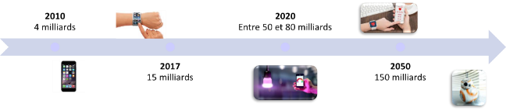

The building revolution
Digital transition introduces « smartness » in the building
One of the digital revolution outcomes : the rapid expansion of IoT
Buildings need to adapt to the new rules of the digital world and become :
User centric
Service oriented
Connected & communicating
Open & secured
Buildings are subject to the laws of the internet era
Usages : variety of choices, increased personalization, ease of access to services, share economy…
Technology : permanent innovation, IP standards, systems interoperability …
Buildings become « service platforms »

Slide 4
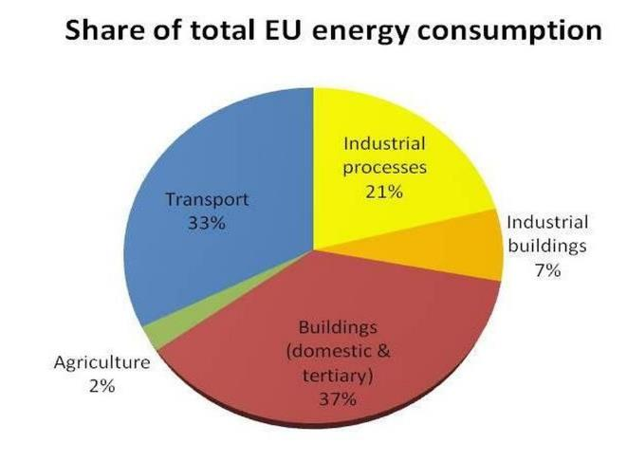


The building’s energy challenges
Today, the building sector represents:
  37% of energy consumption (1).
  28% of greenhouse gas emissions (2).
  The main contributor to power & energy consumption peak
The energy system is changing because of:
  The transition to a greener more decentralized energy production system (solar, wind, geothermal, biomass, etc.)
  The emergence of new uses (electric vehicles, self-consumption, storage, etc.)
(1) In Europe
(2) EDF, 2015
Notes:
Aujourd’hui le secteur du bâtiment en France c’est :
44% de la consommation énergétique. (1)
28% des émissions de gaz à effet de serre (GES). (2)
Aux alentours de 19h00 le secteur du bâtiment est le contributeur majeur de la pointe de la puissance et de la consommation énergétique.
Cette pointe s’accompagne de pic d’émission de GES du fait de la mise en route de moyen de production de pointe.
Dans ce contexte, le système énergétique est en pleine mutation du fait :
de l’apparition d’une transition vers une production énergétique verte et décentralisée (solaire, éolien, géothermie, biomasse, etc.)
de l’émergence de nouveaux usages.
de la probabilité d’une hausse du coût de l’énergie.
de la naissance de stockage énergétique.
Ainsi il est crucial de porter un regard singulier sur la performance énergétique du bâtiment.

Slide 5


Smart Buildings Alliance for Smart Cities
Accelerating Transformation
SBA (Smart Buildings Alliance for Smart Cities) was created in 2012 with the following objectives in mind :
imagine & design the conditions for implementation and development of smart buildings for smart cities, by meeting the challenges of :
  Digital transformation
  Sustainable development
  Emergence of new business models
  Developing a service orientated, user centric approach for smart buildings & smart cities
support stakeholders involved in these transitions
foster the development of new ecosystems leveraging innovation and new services in the context of sustainable development business models.
help to establish a Smart building & Smart City sector of excellence capable of disseminating all around the world

Slide 6



Connected World
ALL Citizens
ALL Buildings
ALL Vehicles
ALL Territory, Equipment & Infrastructure

Slide 7


Vision
Contributing to urban environmental transition
by accelerating impact of digital transition in buildings & cities
Environmental Transition
Digital Transition
X
“The development of new digitally enhanced services in buildings and cities will become possible when traditional silo approaches are overcome”

Slide 8



Mission
Think Tank
Do Tank
THINK
Invent
tomorrow
Impact
today
DO
By SBA
Imagine & design the way forward for Sustainable Urban Development, by meeting the challenges of :
    Digital transformation
    Energy transition
    Sustainable business models
    Service orientated, user centric approach for smart buildings & smart cities
Support stakeholders involved in these transitions
Foster the development of new ecosystems leveraging innovation and new services in the context of sustainable development business models.
Help to establish a Smart building & Smart City sector of excellence capable of disseminating all around the world

Slide 9




Our Scope & Goal
FROM HOMES TO CITIES & TERRITORIES
HOME
BUILDINGS
HOME
Foster the development of open standards, easy to use, affordable smart technologies & services for the smart home.
  Digital Enablement
  Environmental Impact
  « X » as a Service
  New Business Models
  Citizen/User Centric
BUILDINGS
Promote digital connectivity as a prerequisite for smart buildings to become versatile service platforms.
DISTRICTS
Engage smart district planners to take advantage of interactivity with smart buildings.
CITY (& Territories)
CITY
DISTRICTS
Anchor smart building as one of the corner stone of smart city projects.

Slide 10

WHO WE ARE: Members
collective intelligence, transversality, diversity of stakeholders
    Cities & local authorities
    Developers, real estate owners, social landlords
    Architects, Engineering offices, Consultants
    Installers, integrators
    Equipment manufacturers, Solution providers
    Utilities
    Service Providers
    Telecom, networks, IT
    Financial Industry (Bank & insurance)
    Startups
    Training organizations, universities
    Industry associations
    …
560
Network of Innovative
Professionals/Organizations
Members*
* Members as of August 2020

Slide 11
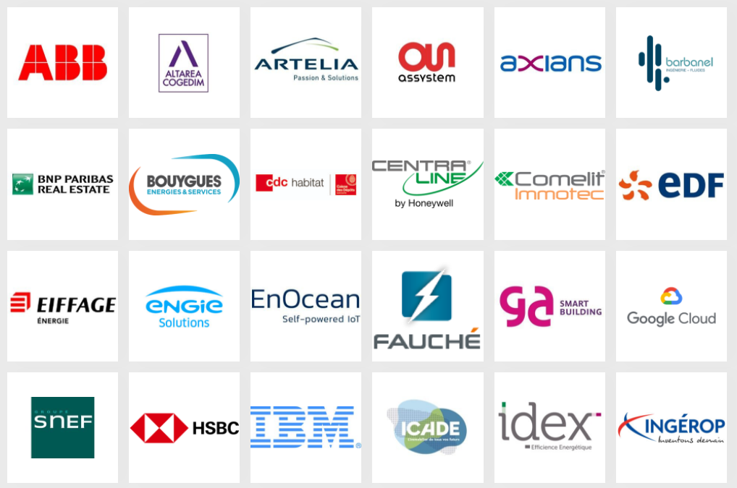
WHO WE ARE: SBA France Honorary Members ● 1/2

Slide 12
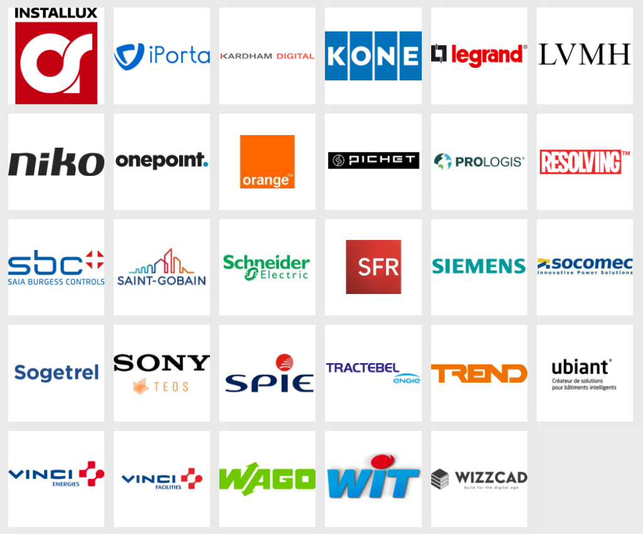
WHO WE ARE: SBA France Honorary Members ● 2/2
… + 450 other
organizations
& enterprises

Slide 13
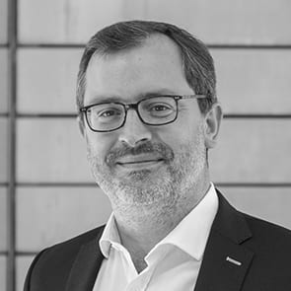















WHO WE ARE: Organization
Advisory Board
President of the advisory board
M. Daumas
ENGIE Solutions
Executive Committee
VP Smart City
VP Smart Building
VP Smart Home
General Secretary
President
E. Etienne-Denoy GREEN SOLUCE
S. Meunier
ABB
FX. Jeuland
NT Conseil
O. Gresle
ENGIE Solutions
Treasurer
Deputy VP-City
Deputy VP-Building
Deputy VP-Home
Deputy VP- G.S.
C. Moulin
CERTIVEA
B. Fiquet
ICADE
C. Rozier
URBAN
PRACTICES
P. Metzenthin
G-ACTIV
E. François
ENOCEAN
V. De Lajarte
PARTAGER
LA VILLE
Management Office
Executive
Officer
International Development
Chief Program
Officer
Marcom Manager
Office
Manager
P. de Carné
M. Claudel
A. Kergoat
D. Briquet
M. Rouanet
Board of Directors
Angelo Blot, MSH LONO
Romain Courrier, NEODOMUS
François-Xavier Jeuland, NT CONSEIL
Valentine de Lajarte, PARTAGER LA VILLE
Philippe Metzenthin, G-ACTIV
Philippe Bonduelle, DECELECT
Alexandre Chaverot, AVIDSEN
Henri Lasseigne, ASCAUDIT
Jérôme Mayet, SETEC
Sylvain Riss, BG 21
Christelle Aroule, SCHNEIDER ELECTRIC
Laurent Bernard, BARBANEL
Doris Birkhofer, SIEMENS
Kevin Cardona, BNP PARIBAS REAL ESTATE
David Desablence, VINCI ENERGIE
Anne Devernois, BOUYGUES ENERGIE SERVICES
Cindy Devillers-Courseaux, EDF
Emmanuel François, ENOCEAN
Benoit Grigaut, ENGIE SOLUTIONS
Paul Raad, WIT
Emmanuel Ballandras, LEGRAND
François Desgardin, NEXITY
Christelle Duverger, VINCI FACILITIES
Olivier Gresle, ENGIE SOLUTIONS
Isabelle Mathé, ORANGE
Pierre-Nicolas Clere, CONNECTING TECHNOLOGY
Ella Etienne-Denoy, GREEN SOLUCE
Frank Fischer, ADEUNIS
Godefroy Jordan, SMARTHAB
Patrick Nossent, CERTIVEA
Philippe Durand, BUREAU VERITAS
Benjamin Fiquet, ICADE
Anne-Françoise Hayman, ARTELIA
Sébastien Meunier, ABB
Stéphanie Vondiere, GA SMART BUILDING
Christophe Colinet, BORDEAUX METROPOLE
Delphine Eyraud, GIMELEC
François Loch, AFPA
Anne-Sophie Perrissin, IGNES
Stéphanie Tucoulet, ANITEC

Slide 14
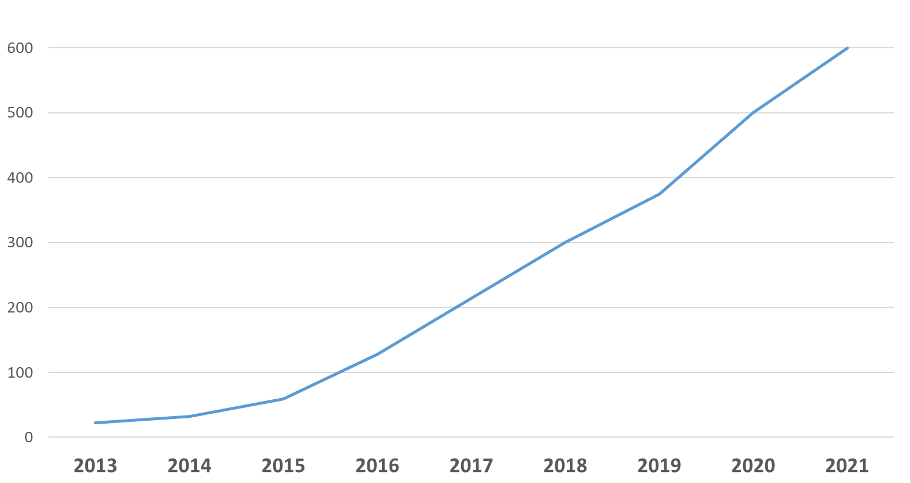








Key Milestones
600°
Smart Building
Smart
City
Smart
Home
MOOC
label
300°
label
label
200°
Charte Bâtiment connecté
label
100°
Creation
Regional expansion
International expansion

Slide 15
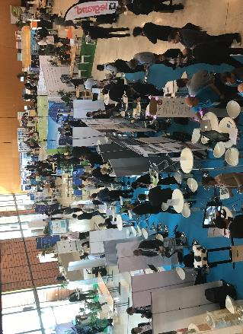


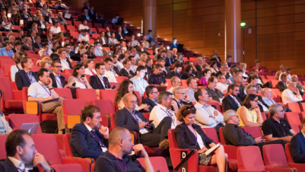

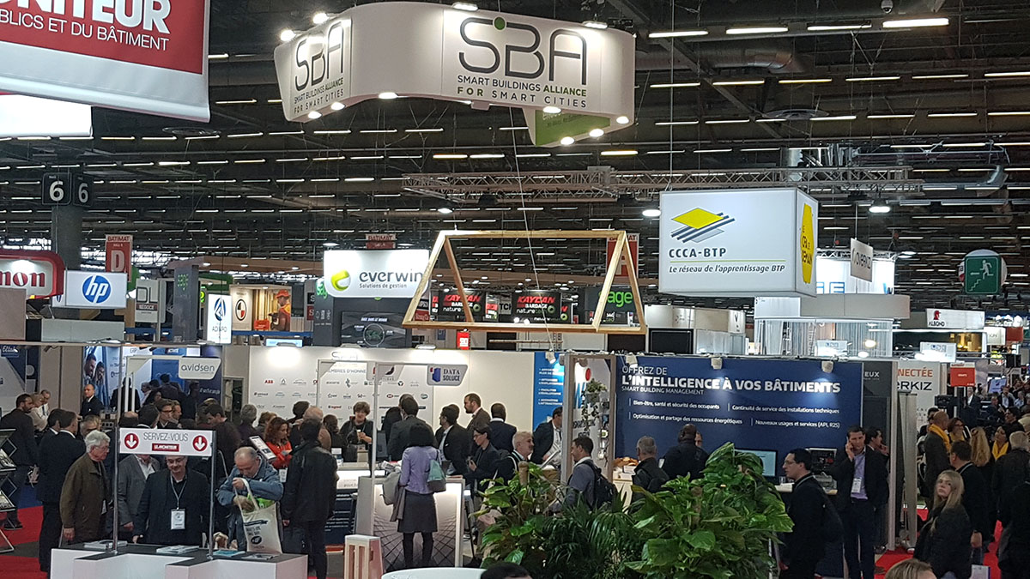
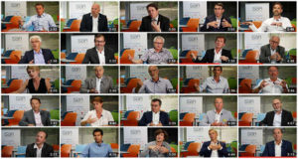
WHAT WE DO: Events, Trade Faires & Public Relations
Gathering Members for
Network Events & Sharing Experiences
Founding Partner of SB4SC* Universities
* Smart Buildings for Smart Cities
Organizing
Thematic Conferences
Sharing new ideas & vision
In the scope of Smart Buildings for Smart Cities
Promoting Innovation at major trade fairs
through Village by SBA
Offering Speaking Opportunities
for Innovators & Thought Leaders

Slide 16












WHAT WE DO: SBA Publications & Thema Guides
Smart
Territories
Smart
Social Housing
Smart Parking
mobility services
Safe & Secure
Territory
Smart Lighting
Smart Hospital
SBA Manifesto
Connected Building
Charter
Ready2Service Framework
BIM4Value Framework

Slide 17
WHAT WE DO: Active Work Groups
Home
Building
City
Global
R2S Residential buildings
R2S commercial buildings (v2)
R2S District Development
R2S CONNECT
R2S 4 MOBILITY
Network & Protocols
R2S 4 GRIDS
DC & DIGITAL
R2S 4 CARE
ARTIFICIAL INTELLIGENCE
R2S 4 SPACES
BLOCKCHAIN
R2S 4 HEALTH & WELLBEING
PROSPECTIVE
R2S 4 SAFETY & SECURITY
SAFE CITY
CARBON FOOTPRINT
BIS / BOS
REGULATIONS
BIM 4 VALUE
CIM
User Value Proposition
BUILDING RENOVATION
CHANGE MANANGEMENT

Slide 18
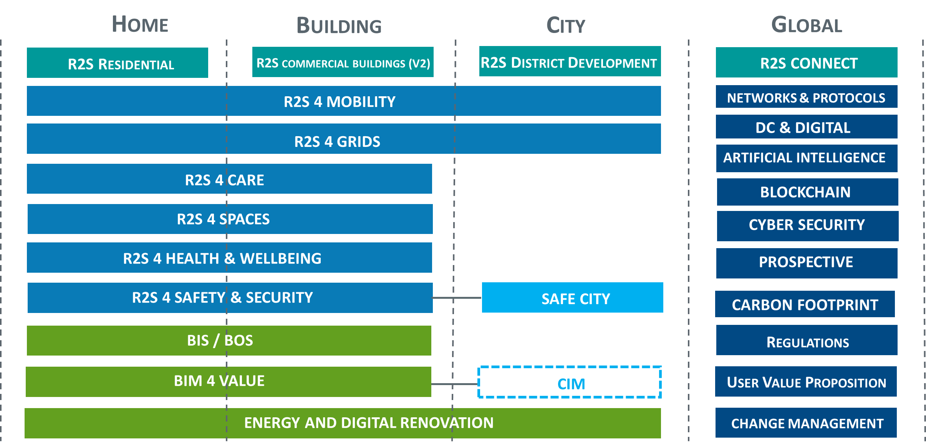
WHAT WE DO: Active Work Groups

Slide 19














WHAT WE DO: Regional Coverage
Normandie
Hauts de France
Bretagne
Grand Est
Pays de la Loire
Centre & Val de Loire
Auvergne Rhône Alpes
Nlle Aquitaine
PACA
Occitanie

Slide 20









Going Internationnal
Opening in 2020
Under discussion …
SBA
International
HQ
Germany
UK
USA
France
Created
2012
Luxembourg
Planned opening
2020
Belgium
Planned opening
2020
Switzerland
Planned opening
2020
Italy
Planned opening
2020
China
Tunisia / Morocco / Algeria
Nordics
Canada
and more …
Our Next Step:

Slide 21
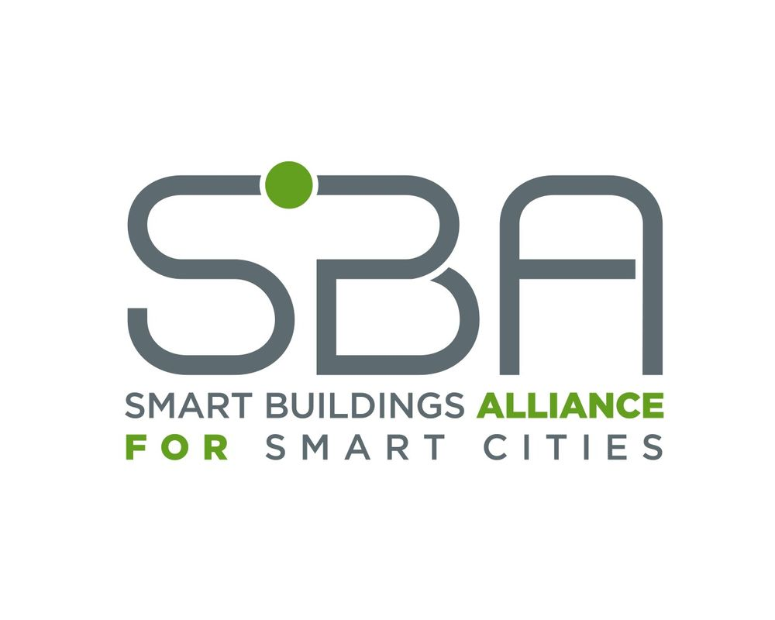
Going Internationnal
Smart Home Work Groups
Smart Building Work Groups
Smart City Work Groups
Global Work Groups
Promote SBA’s Philosophy & Work in each country/region
Contribute to foster innovation in urban development & building sector
INTERNATIONAL
International Network
of Urban Innovators

Slide 22
SBA
WORK THEMES

Slide 23
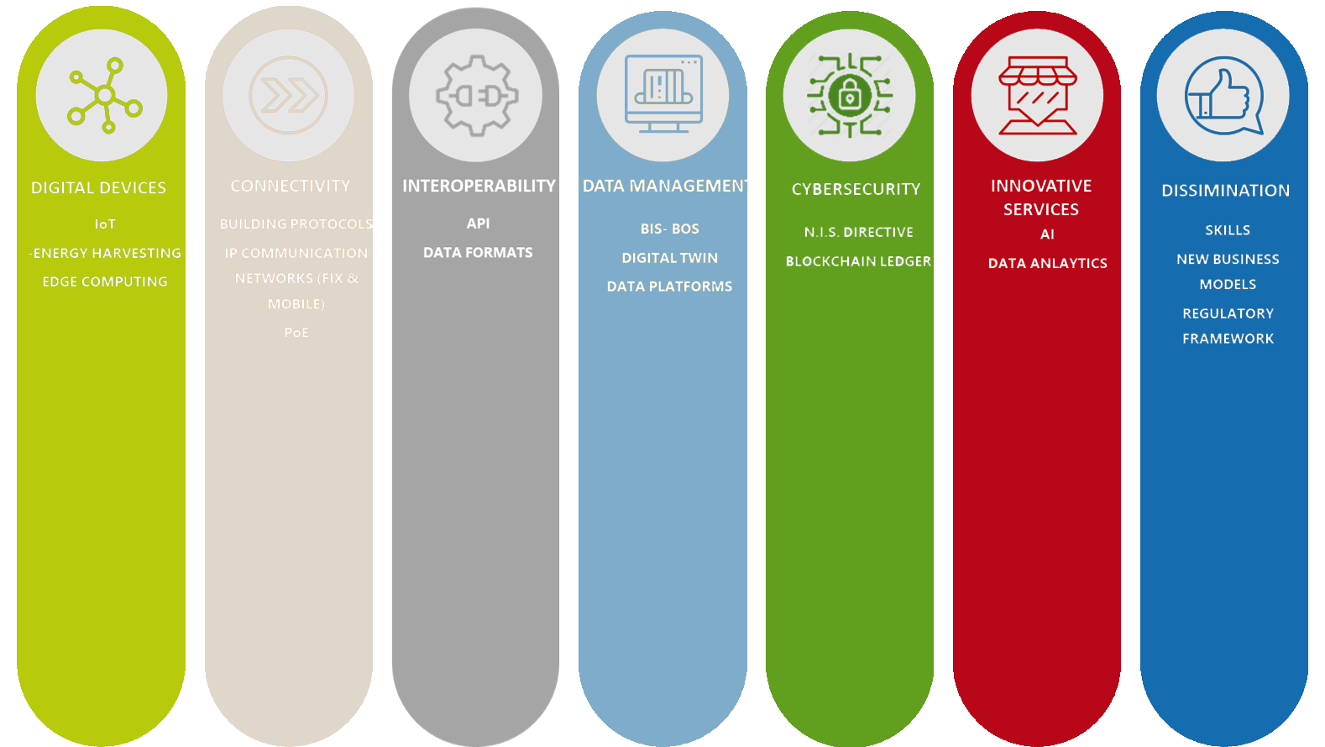
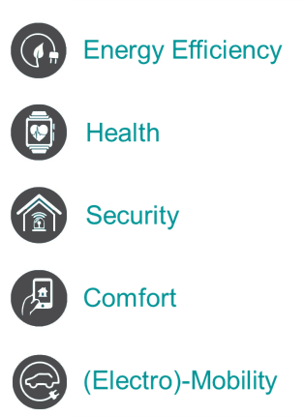
Strategic domains & fields of interest

Slide 24

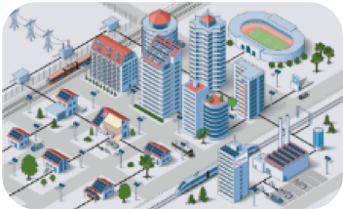


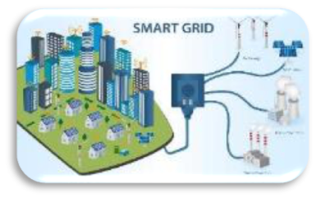

Citizen centric smart cities
Activities : business, retail, education, health…
Buildings : residential, workspaces, commercial activities, public services …
Mobility : services, transportation, traffic, parking
Public infrastructures : networks, lighting, security…
Energy, fluids, waste …
Smart City – Smart Citizens

Slide 25

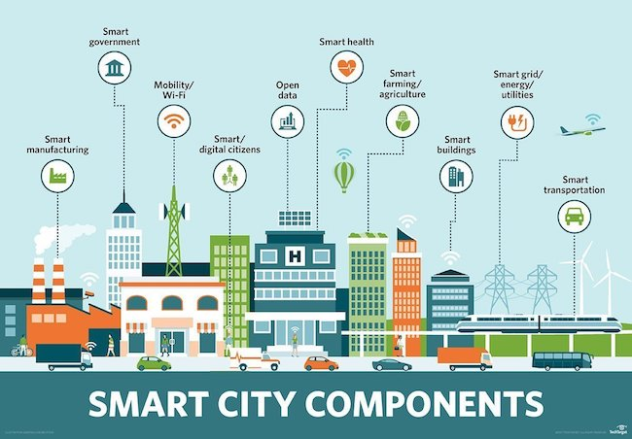



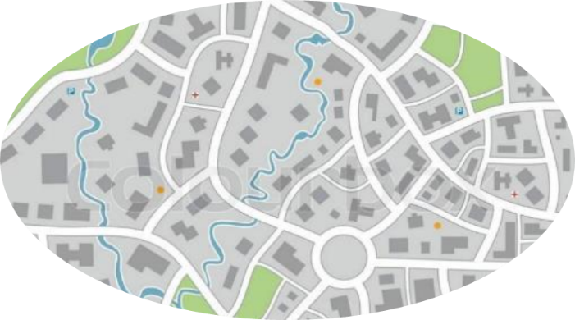








From homes to cities territories
A quest for services continuum
Digital Display
Mobility
Lighting
Energy
Water
Recycled wastes
Parking
Shared Spaces
Assisted Living
Last km
logistic
Source: https://internetofthingsagenda.techtarget.com/

Slide 26








Buildings to share many resources with smart city
Smart City starts with Smart Buildings
        Smart Buildings are the 1st piece of the puzzle
Smart City : A Continuity of the Smart Buildings
        Continuity of services for user from Smart Buildings to Smart City
        Towards 3D Territories (Digital, Decarbonate, Decentralized)
Smart Buildings / Smart City share common objectives
        More services closer to the citizens / users
        Accessible for all
        Increased well being
        Sustainable
        Safer
Energy
Mobility
Data
Services
(ex: Hospitality,
Health, Logistic …)
Shared Spaces
(coworking, coliving …)

Slide 27
Ready2Services
Reference Framework
SBA & Ready2Services (R2S)
Creating the framework to foster
smart buildings for smart cities
connected & sustainable development

Slide 28




Commercial buildings
R2S for Commercial Buildings
R2S for Residential Buildings
R2S for District Development

Slide 29




connectivity
The 6 pilars of « R2S » label
network architecture
Ensure efficient building connectivity capabilities to external telecom networks
Ensure seamless data flows within the building
Describe buildings’ « 4th fluid » network
Efficient Wi-Fi & GSM coverage
Cabling redundancy, flexibility, access protection …
Define the buildings’ converged IP network
Set the conditions to efficient management of building network and building data flows

Slide 30




Interoperability
The 6 pilars of « R2S » label
Digital security
Establish the conditions to foster interoperability between independant systems
Secure building systems
Protect building & personnal data
Set the framework for building systems interoperability conditions (Open API, webservices …)
Promote BIM as a central « operations » tool for building systems
Protect building systems against risks, vulnerabilities and attacks
Strengthen the protection of occupants' personal data

Slide 31



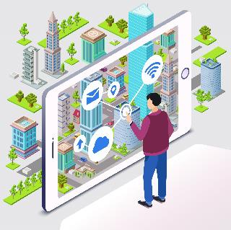
Sustainable management
The 6 pilars of « R2S » label
services
Set the framework for best of breed sustainable project management practices
Foster development of new services for the building and its occupants
Framework to monitor project management, project costs & project planning
Commissioning process of building systems
Increased comfort, safety and quality of user experiences
Optimization of building maintenance and operations

Slide 32
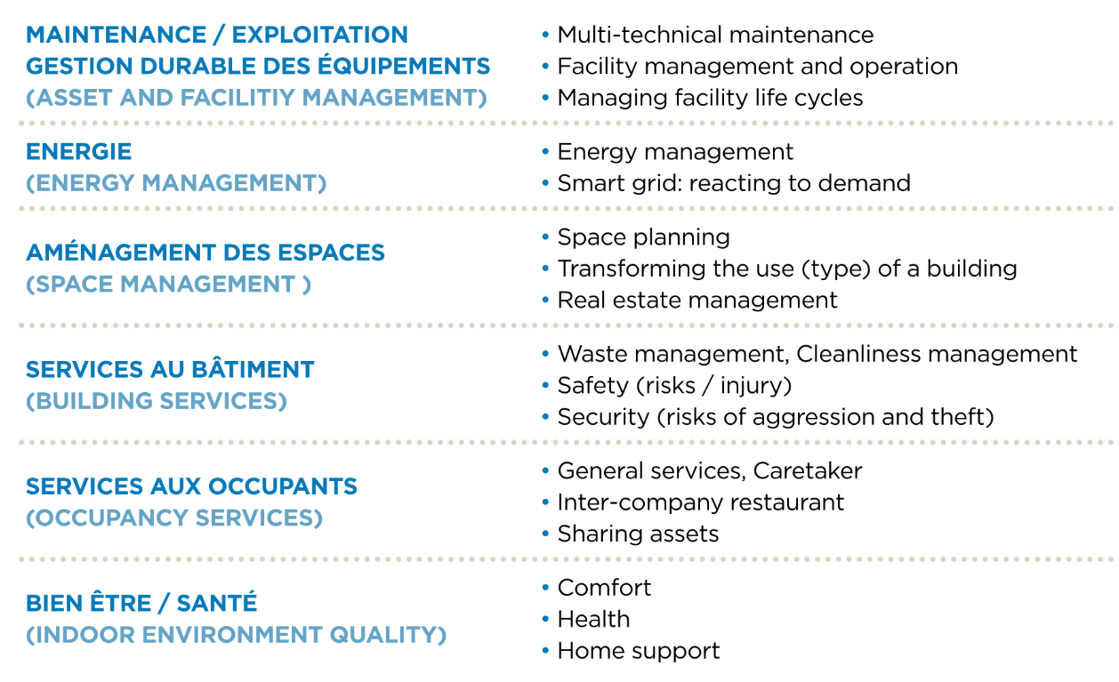
Example of services
services

Slide 33


The need for a new approach promoting value of services
INCREASE CAPITAL VALUE
SERVICES
“smartness”
enhances services,
but requires a framework to operate efficiently
Usage economy
(*value is a function of services delivered to users)
The « 3L*» law
(*value is a function of location x location x location)

Slide 34


Benefits of R2S approach
Provide more Services
Optimize
Operations
Improve flexibility of usages
Increase property
value / attractiveness

Slide 35
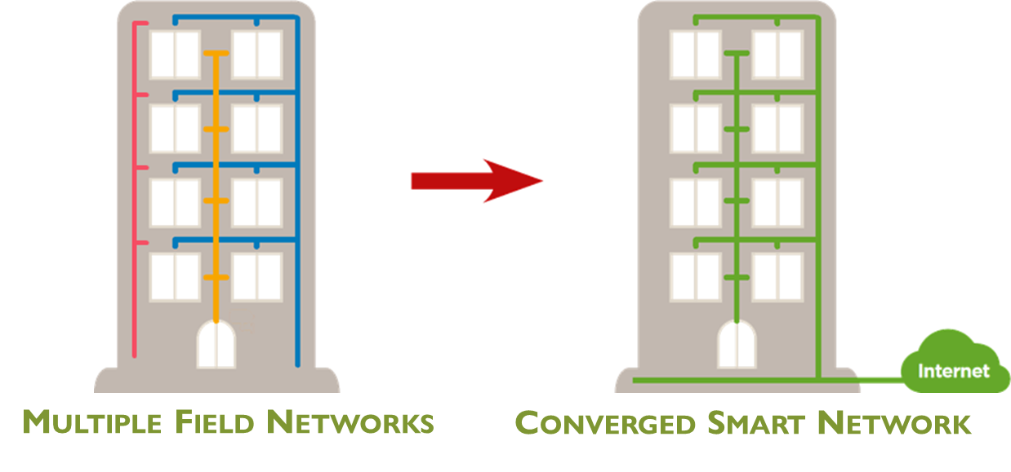
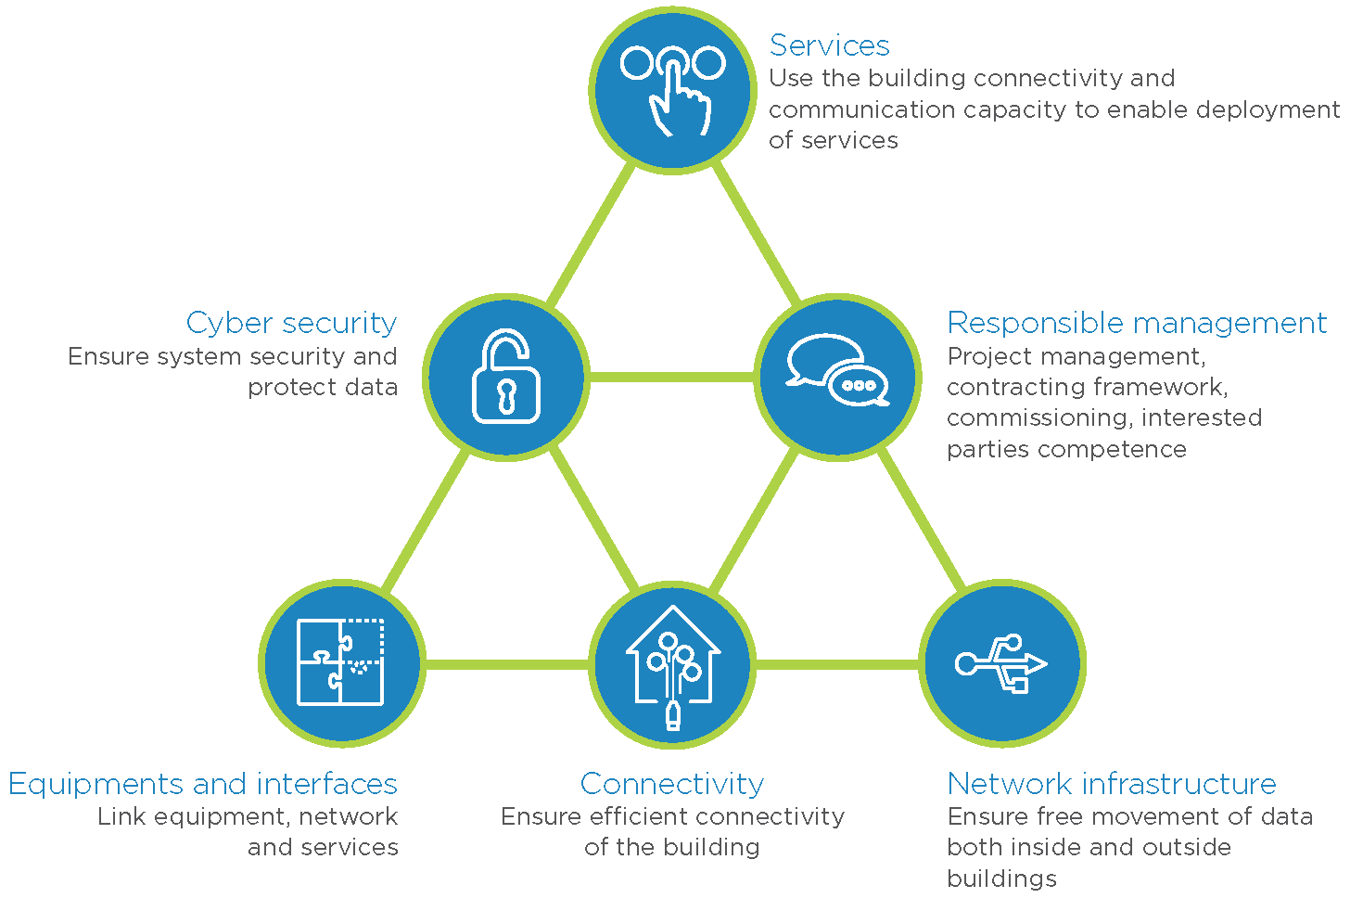
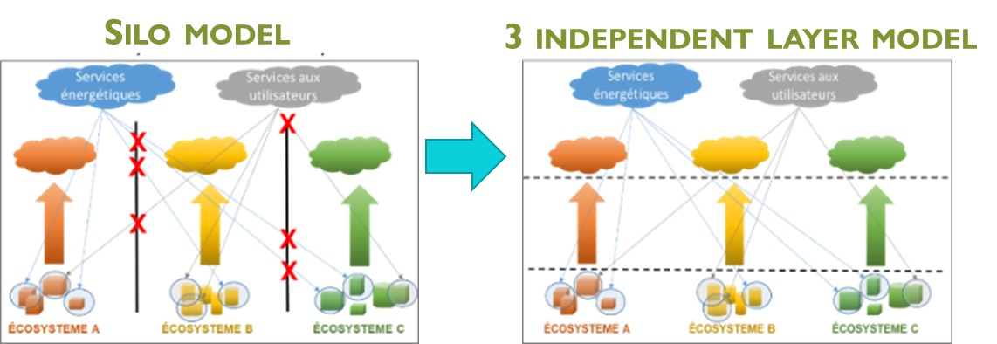
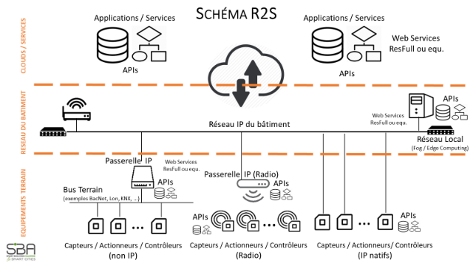

General framework for building connectivity and beyond
Converged Smart Network for the building based on Ethernet – IP
the infrastructure of the building’s 4th fluid (data)
Modular architecture based on 3 independent layers
Open access to data and interoperability of systems

Slide 36
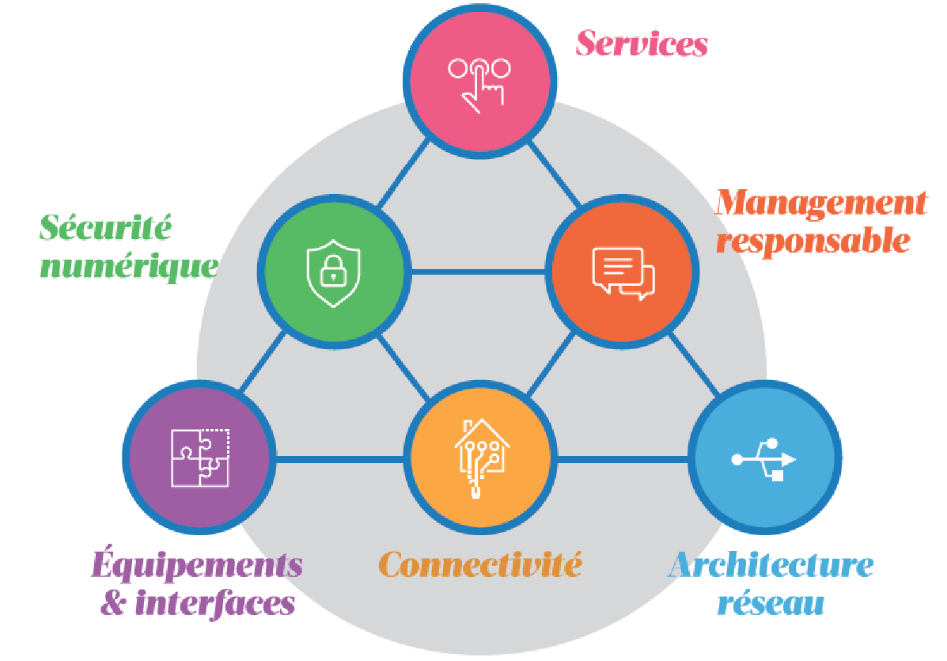





The framework for connected & communicating buildings
Services to building stakeholders
Governance
Technical Principles
Charte du bâtiment connecté, bâtiment solidaire et humain
Signed by over
100
Industry stakeholders

Slide 37
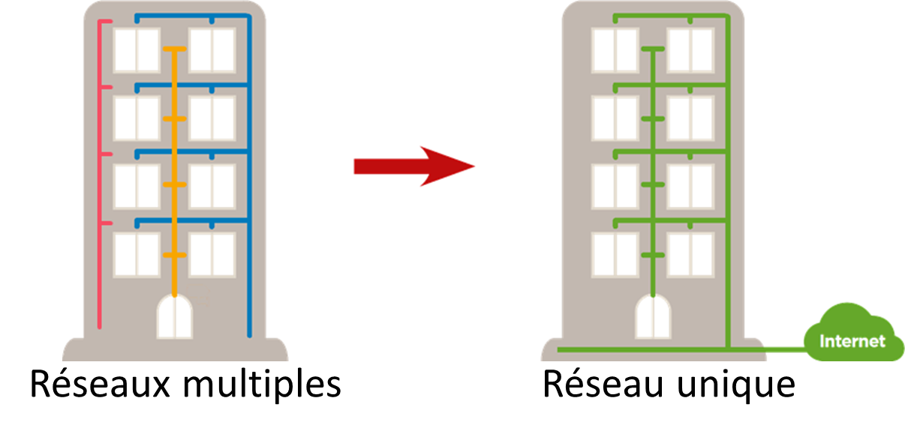
Principles underlying R2S framework ● 1/4
Converged Smart Network for the building based on Ethernet - IP
This is the infrastructure of the building’s 4th fluid (data) …
based on a standard and universal data transport protocol Ethernet – IP, this infrastructure includes, wired or wireless connectivity for the transportation of data, as well as network management systems, routing and logical organization of data flows and network services for the building.
Multiple Field Networks
Converged Smart Network
principles underlying framework (1)

Slide 38
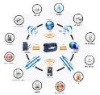


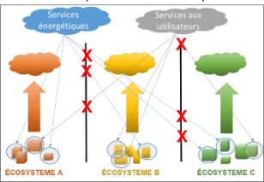
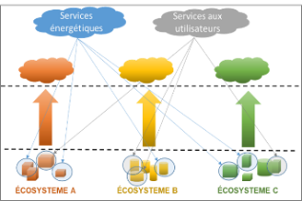
Principles underlying R2S framework ● 2/4
Modular architecture based on 3 independent layers
Each technical layer : Field systems, Network/Digital infrastructure & Service, should be able to be changed without modifying the others two …
A hardware ecosystem does not impose a proprietary service or a dedicated network/digital infrastructure and vice versa
Silo model
3 independent layer model
Data
Filed
systems
NetworkDigital
Services

Slide 39

Principles underlying R2S framework ● 3/4
Open access to data and interoperability of systems
Use Open API (Application Programming Interfaces) to allow easy access to data …
produced and / or used by the connected devices and related services, whether the services are available locally and / or through the cloud. Ensure existence of documentation and licenses of use are available and accessible to third parties.
API Documentation
& user licences

Slide 40


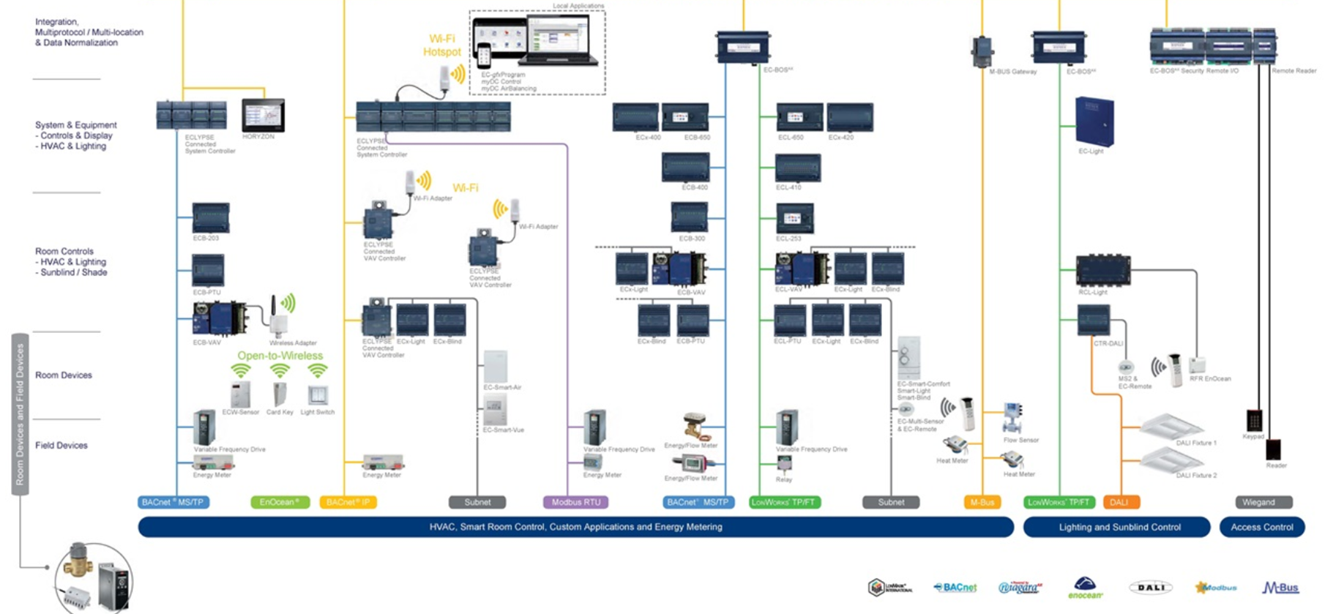
R2S Connect
SMART SERVICES
Building Smart Network ( Ethernet-IP)
Central API
Field API

Slide 41
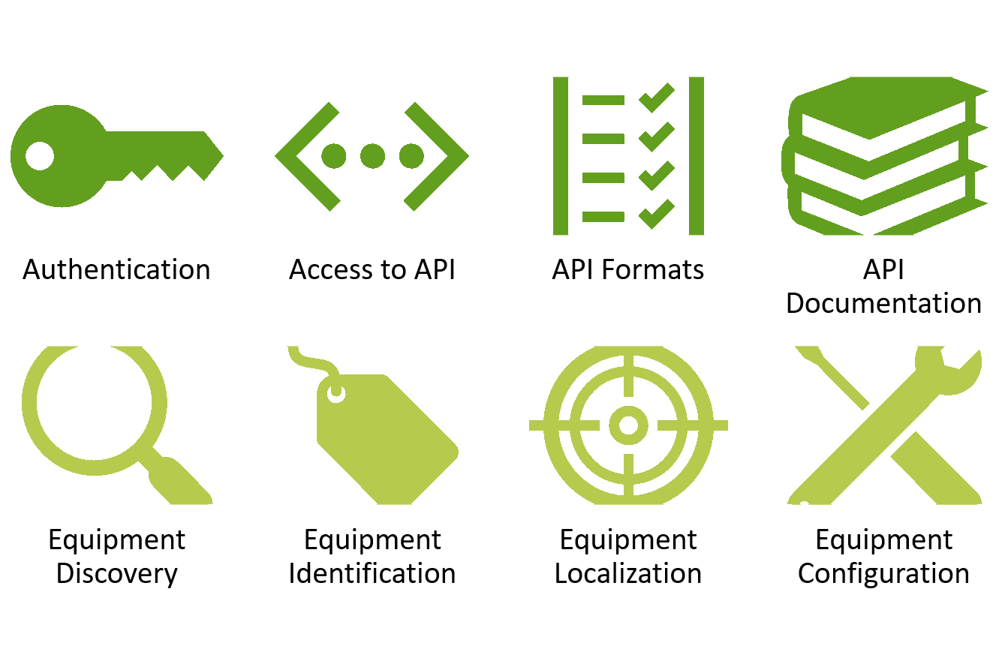
API Guidelines

Slide 42


Principles underlying R2S framework ● 4/4
A trusted framework for digital security and data protection
Making accessible and controllable building functions locally or remotely via digital tools, requires to consider systems (equipment, networks, services, data) security policies , as well as data protection procedures (data administration policy, new European regulation on data protection : GDPR ...).

Slide 43

principles underlying « Ready2Services » approach (5)
Ready2Services provides the building with essential qualities to become an open service platform*
Energy Services : real-time monitoring, archiving and logging of building energy profile, provision of dashboards and invoices, analysis of the energy profile, prediction and decision support, opening of the building to smart grid.
Building Services : communication services for common areas, multi operation management, building maintenance, building safety and security, control of comfort parameters, well-being and health (temperature, humidity, lighting, air quality, sound levels ...
User Services : private areas communication services, location-based services, signaling and guidance, dynamic information display, real-time management of shared resources: meeting and video conference rooms, parking spaces, coworking spaces, relaxation areas, ...
* As part of the R2S labeling process for non-residential buildings, an energy monitoring service using the R2S infrastructure is required upon delivery of the building

Slide 44




R2S certified label for business premises
Delivered by Certivea
A label issued by Certivea for business premises : offices, shops, hotels, sports equipment ...
meeting the criteria of SBA’s Ready2Services reference framework
Design
Phase
Building
Phase
Operations
Phase
New construction
Renovation
Stakeholders
Construction/Renovation : building developpers real estate owners,
Operations : real estate owners, occupants
Official launch : June 2018

Slide 45

Residential buildings
R2S for Commercial Buildings
R2S for Residential Buildings
R2S for District Development

Slide 46







R2S for residential buildings
base
Energy & Fluids
Comfort & Well-Being
security
Digital Trust Framework
Smart & Sustainable Management
Digital services & usages
Technical & Organizational
Foundations
E-Health & Personal Care
Service Domains
Connectivity
&
Smart Network
Equipment
&
Interfaces
Shared Services
Operations & Management

Slide 47
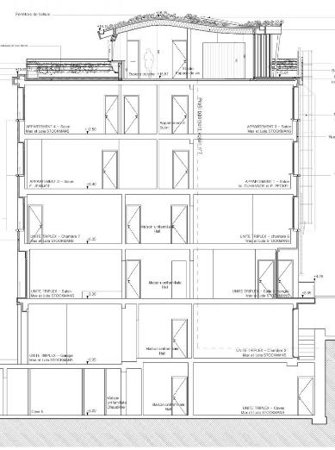











Smart résidential building vs smart home (owned by occupant)
Smart Residential Building
« attached to building»
Smart Home
« attached to occupant »
Personal IoT devices
Building IoT Devices
Smart Home Gateway
Gateway
to Dwelling
TELECOM
Building Smart Network

Slide 48

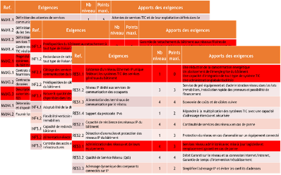
Ready2Services self evaluation* for residential buildings
Responding to the same principles as those applicable to business premises the proposed approach for residential buildings is a self-evaluation by project owners based on a self-assessment grid adapted to residential buildings available directly from SBA.
*Available Q4 2018

Slide 49
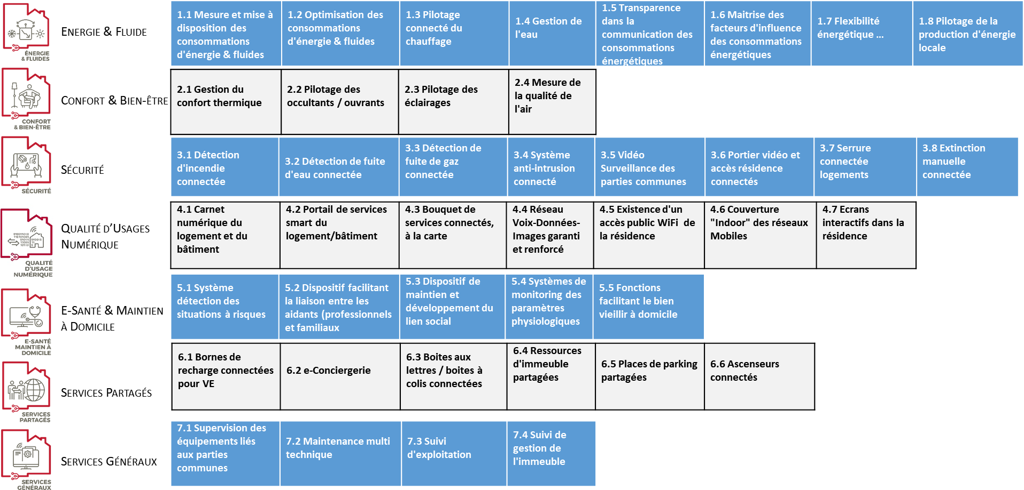
Service families for R2S Residential
to be translated

Slide 50
R2S FOR
Reference Framework

Slide 51
Districts
R2S for Commercial Buildings
R2S for Residential Buildings
R2S for District Development

Slide 52






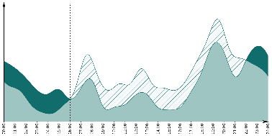
Data communicated by a « R2G » building
An R2G building is able to communicate a set of key energy data
  The identity card of the building
  Energy data
  Influencing factors
  Receive flexibility orders
An R2G building is able to communicate this data in an open, interoperable and secure way

Slide 53
Challenge of the smart city
    Smart Cities strive to catch up with digital transition, requiring new collaboration strategies
  Promote positive externalities by involving all actors of the value chain
  Develop a global & holistic vision vs current silo approach
  Foster a collaborative and inclusive economy
  Involve & empower the different stakeholders
    New Business models based on
  “Everything” as a Service
  Share economy
  Crowdfunding
  Blockchain / Virtual local currencies
  …
Technical
R2S enabled urban infrastructure
Organizational
Multi Scale – Multi Service Urban Operator
Urban Data Platforms
Smart Contracts / Virtual local currencies
Citizen engagement & empowerment
New regulatory frameworks
    Prerequisite
Challenge of the Smart City

Slide 54
Emergence of new players & business models
    Service Operators
  Smart Buildings & Smart City local service aggregation
  New innovative Business Models enabling interaction
  between heterogeneous players (create value
  from positive externalities)
    Trusted Third Parties for Urban Data Management
  Provides a consolidated Urban Data Platform
  Warrant for security and confidentiality of Data
  Warrant of the contractual terms of data distribution

Slide 55

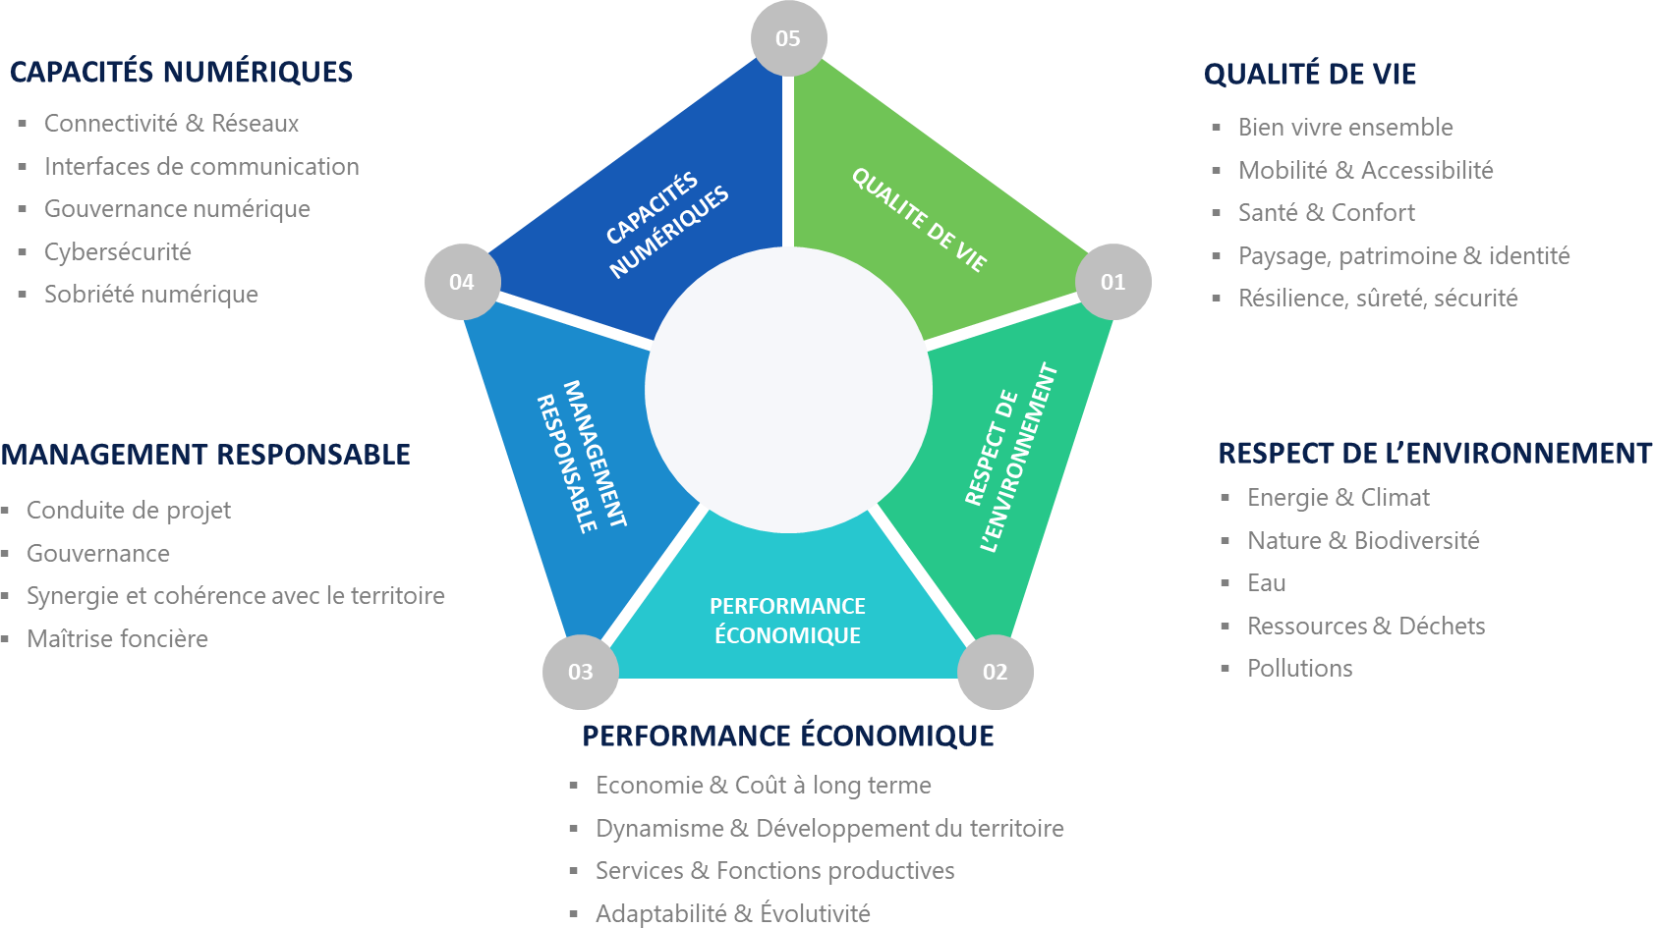





R2S for district developpement
CONNECTIVITÉ & RÉSEAUX
INTERFACES DE COMMUNICATION
GOUVERNANCE NUMÉRIQUE
CYBERSÉCURITÉ
to be translated
SOBRIÉTÉ NUMÉRIQUE

Slide 56
R2S: a global approach
applied to multiple scales & multiple service domains
R2S for Commercial Buildings
R2S for Residential Buildings
R2S for District Development

Slide 57

R2S framework expanded to service domains
Safety & Security Services
Building Occupancy Services
Mobility Services
User Wellbeing Services
Energy Services
Care Services
Other Services …

Slide 58



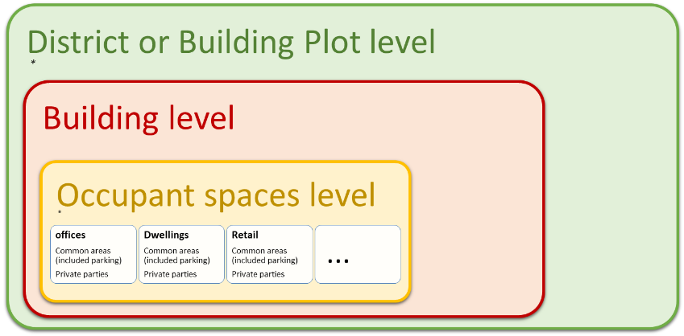
R2S 4 GRIDS – reference framework
  R2S-4Grids is the energy extension of R2S reference framework shared by the ecosystem of building developers and energy stakeholders
  A framework that applies to commercial buildings as well as collective housing, new construction or renovation.
  A framework dedicated to building owners and developers
  A framework allowing buildings to host a set of innovative energy services and become players in the energy transition.
Notes:
Il s’applique aussi à des groupes de bâtiments

Slide 59


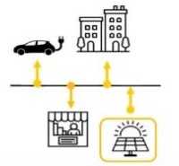
Fonctionnal properties of an R2S 4 GRIDS building
Energy Dashboard
3 levels of functionalities for the R2S-4Grids building
Level 1 – Connected Building
  Share data and receive consumption information
Level 2 – Reliable Building
  Know energy production, consumption and stick to objectives
Level 3 – Active Building
  Modulate production, consumption and storage according to requests, forecasts ...
control of the energy bill and tariff optimization
Connected
Reliable
maximizing collective
self-consumption
Active

Slide 60








R2S 4 MOBILITY
Technical & Organizational
Mobility Services
RECHARGING INFRASTRUTURE & ENERGY MANAGEMENT
RECHARGING SERVICES
BUILDING INFRASTRUCTURE
EQUIPMENT
& INTERFACES
DATA MANAGEMENT
CYBERSECURITY
QUALITY MANAGEMENT SYSTEM
MOBILIY HUB
SMART PARKING
ACCESS TI BUILDING SPACES & SERVICES

Slide 61
BIM
FOR
VALUE

Slide 62

Beyond R2S the need to foster a data management culture

Slide 63
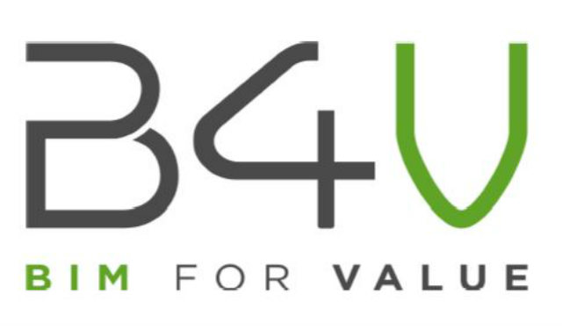



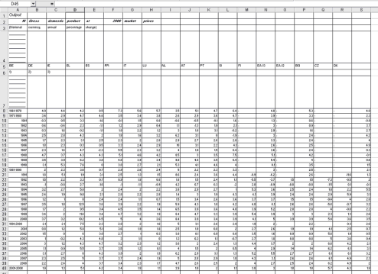
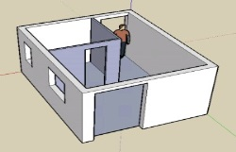

BIM 4 VALUE
Data Flow … needs continuity … at each step
Design BIM
Build BIM
Operations BIM
Building Structure
Technical Systems
Unified BIM

Slide 64
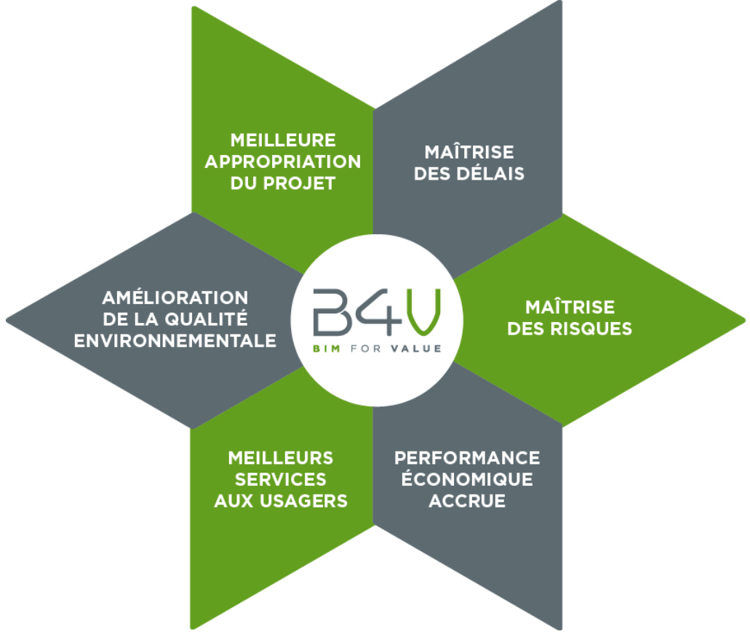
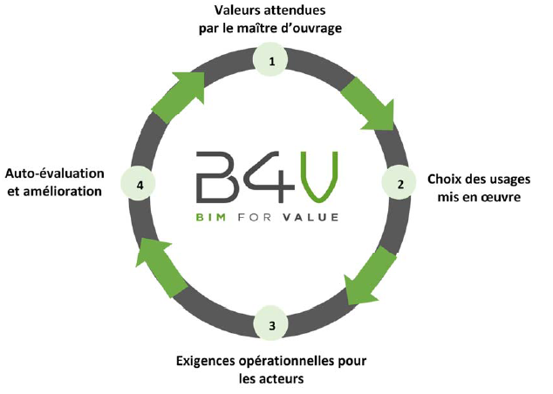
BIM 4 VALUE – METHODOLOGY & BENEFITS
Setting expectations from
Building Developers/Owners
Project
Buy-in
Better control over delays
Controlling through auto evaluation and improvement process
Selecting BIM usages to be implemented
Improved process & quality
Risk
Mitigation
Enhanced User Services
Increased Economic Performance
Integrating Project stakeholders’ operational requirements
Methodology
Benefits

Slide 65
BUILDING INFORMATION SYSTEM (B.I.S.)
System Management
B.I.S Quality Management & Operation process
External Applications & Services
ERP
Asset Mgt
Analytics
Others …
Building Applications & Services
Energy
Management
Space
Management
Operations &
Maintenance
BACS
Digital Twin
Others …
Data Management
Common data framework (naming, semantic, ontology)
Dynamic storage of building’s heterogenous data
Link to BIM ( Building Information Modelling)
Cybersecurity & Data protection
Authentication, Authorization & Accounting, Encryption …
GDPR, anonymization …
B.O.S. ( Building Operating System)
Collect, manage & distribute sets of building data, orchestrate processes
Equipment (Connected field systems, IoT …)
Safety
&
Security
Occupancy Management
Others …
Elevators, Signage, etc.
HVAC
Metering
Automation
(Lights, Blinds …)

Slide 66




In summary: SBA is pionneering the way forward
For framin the smart building blocks
New Usages, Business Models & Legal Frameworks
Impacting
Technologies
&
Open Standards
AI
Wireless (5G…)
Blockchain
DC
Cybersecurity
Open API
…
Building & User Services
…
Building Operating System
Service Domains
Data Models
Communication Infrastructure
Digital Twin
Field Systems (BACS …)
Digital Infrastructure
Framework for Buildings
BIM
Building Structure
End to End BIM Methodology
for framing the Smart Building Blocks
In summary : SBA is pioneering the way forward

Slide 67

Thank You for your attention
Presentation prepared by SBA – All rights reserved www.smartbuildingsalliance.org

